Slide 1
Towards Feed-forward 3D Reconstruction
Yu-Chun Lin

Slide 2
Contents
Background
3D Reconstruction
Basis
Traditional Methods
Deep Learning
Feed-forward 3D Reconstruction
Current Problems
Scope of Improvement
Technical Highlights of Current Methods
Applications

Slide 3
What is 3D Reconstruction?
The process of creating a digital three-dimensional model of an object or scene from data. It turns (2D) observations into a usable 3D model.
Videos
(ordered/unordered) Images
Depth (Kinect, LiDAR)?
IMU?
…
Point cloud: A set of 3D points
Meshes: Points connected into triangles
Voxel: A 3D pixel
NeRF, 3D Gaussians, …
Notes:
A mesh consists of: Vertices, Edges, Faces (usually triangles)

Slide 4
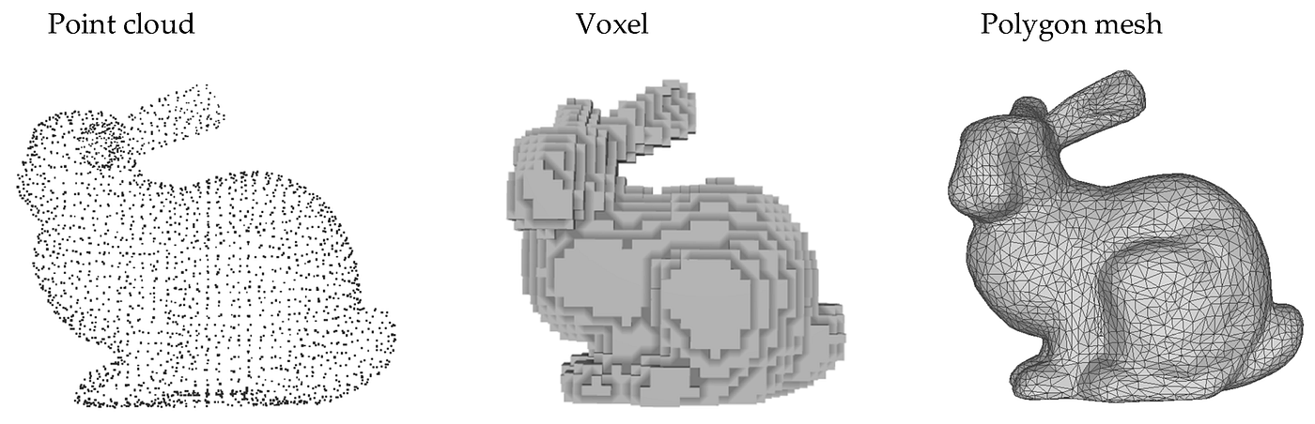
What is 3D Reconstruction?
The process of creating a digital three-dimensional model of an object or scene from data. It turns (2D) observations into a usable 3D model.
https://miro.medium.com/v2/resize:fit:1400/0*l233ieenj80ogEOa.png
Notes:
A mesh consists of: Vertices, Edges, Faces (usually triangles)

Slide 5
Overview
3D Reconstruction
Structure-from-Motion
(SfM)
Simultaneous Localization and Mapping
(SLAM)
Others
Offline
Online
COLMAP
ORB-SLAM 2/3
DSO
LSD-SLAM
- Input: Images
- Output: Point Cloud
Notes:
A mesh consists of: Vertices, Edges, Faces (usually triangles)

Slide 6
3D Reconstruction Methods
Deep Learning
Optimization-based
Optimization-based
Feed-forward
With Global Alignment:
DUSt3R, MASt3R
Scene Coordinate Reconstruction:
ACE0
Others:
FlowMap, VGGSfM
VGGT-based:
SAIL-Recon
DUSt3R-based:
Cut3R, Fast3R
Incremental:
COLMAP
Global:
GLOMAP

Slide 7
3D Reconstruction Methods
Deep Learning
Optimization-based
Optimization-based
Feed-forward
With Global Alignment:
DUSt3R, MASt3R
Scene Coordinate Reconstruction:
ACE0
Others:
FlowMap, VGGSfM
VGGT-based:
SAIL-Recon
DUSt3R-based:
Cut3R, Fast3R
Incremental:
COLMAP
Global:
GLOMAP

Slide 8
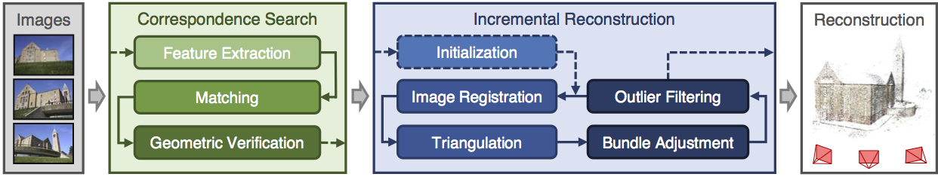
COLMAP
A system for SfM + Multi-View Stereo (MVS)
Input: (Un)ordered images
Output: Point Cloud & Estimated camera poses
https://colmap.github.io/tutorial.html
Notes:
World to camera transformation

Slide 9
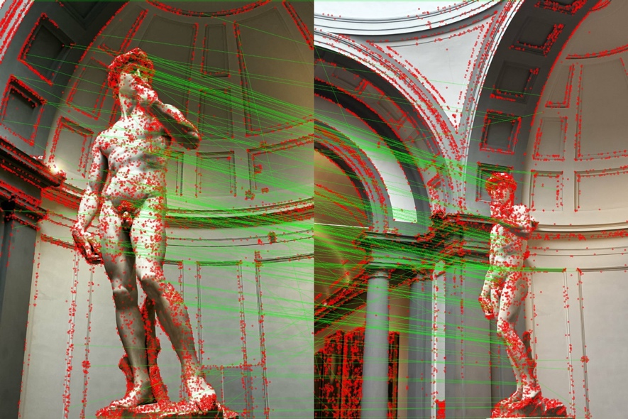
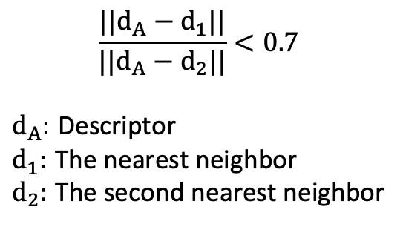
COLMAP: Feature Matching
SIFT (Scale-Invariant Feature Transform)
128-dimension descriptors of keypoints
Compare each descriptor of A with all descriptors of B
Use L2 distance to find the nearest neighbor
Lowe’s ratio test
$$\frac{||d_{A}−d_{1}||}{||d_{A}−d_{2}||}<0.7$$
$d_{A}:$ Descriptor
$d_{1}:$ The nearest neighbor
$d_{2}:$ The second nearest neighbor
Notes:
Rotation invariant, translation invariant

Slide 10
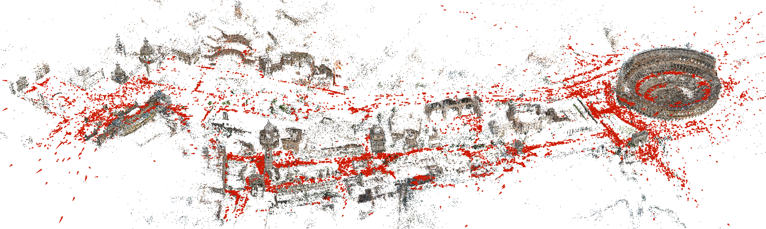
COLMAP: Incremental Reconstruction
Initialization: Camera poses & 3D points
Select next image to be added (i.e. overlap)
Solve for camera pose of the added image
Triangulate new 3D points
Bundle adjustment
https://colmap.github.io/tutorial.html
Notes:
Rotation invariant, translation invariant

Slide 11

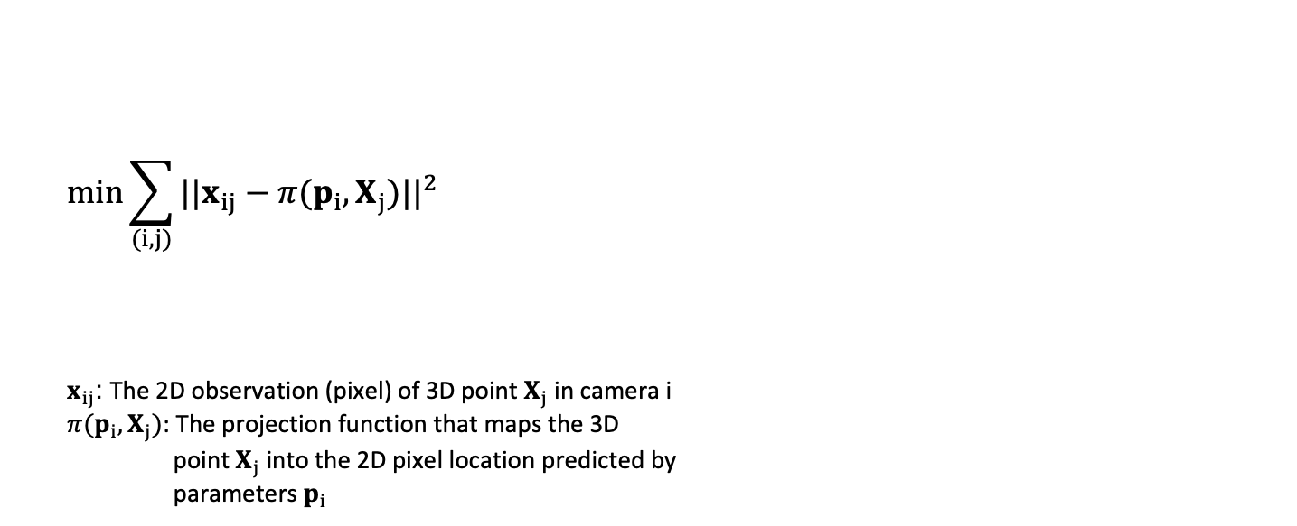









COLMAP: Bundle Adjustment
Least squares approach to jointly estimate camera poses and 3D points
Minimize “reprojection error”
$$X_{j}$$
$$\min_{ }{\sum_{(i,j)}{{||x_{ij}−π(p_{i},X_{j})||}^{2}}}$$
$x_{ij}$: The 2D observation (pixel) of 3D point $X_{j}$ in camera i
$π(p_{i},X_{j})$: The projection function that maps the 3D
point $X_{j}$ into the 2D pixel location predicted by
parameters $p_{i}$
$$π(p_{1},X_{j})$$
$$x_{ij}$$
$$x_{1j}$$
$$π(p_{2},X_{j})$$
$$π(p_{i},X_{j})$$
$$x_{2j}$$
$$p_{i}$$
$$p_{1}$$
$$p_{2}$$
Notes:
Rotation invariant, translation invariant

Slide 12
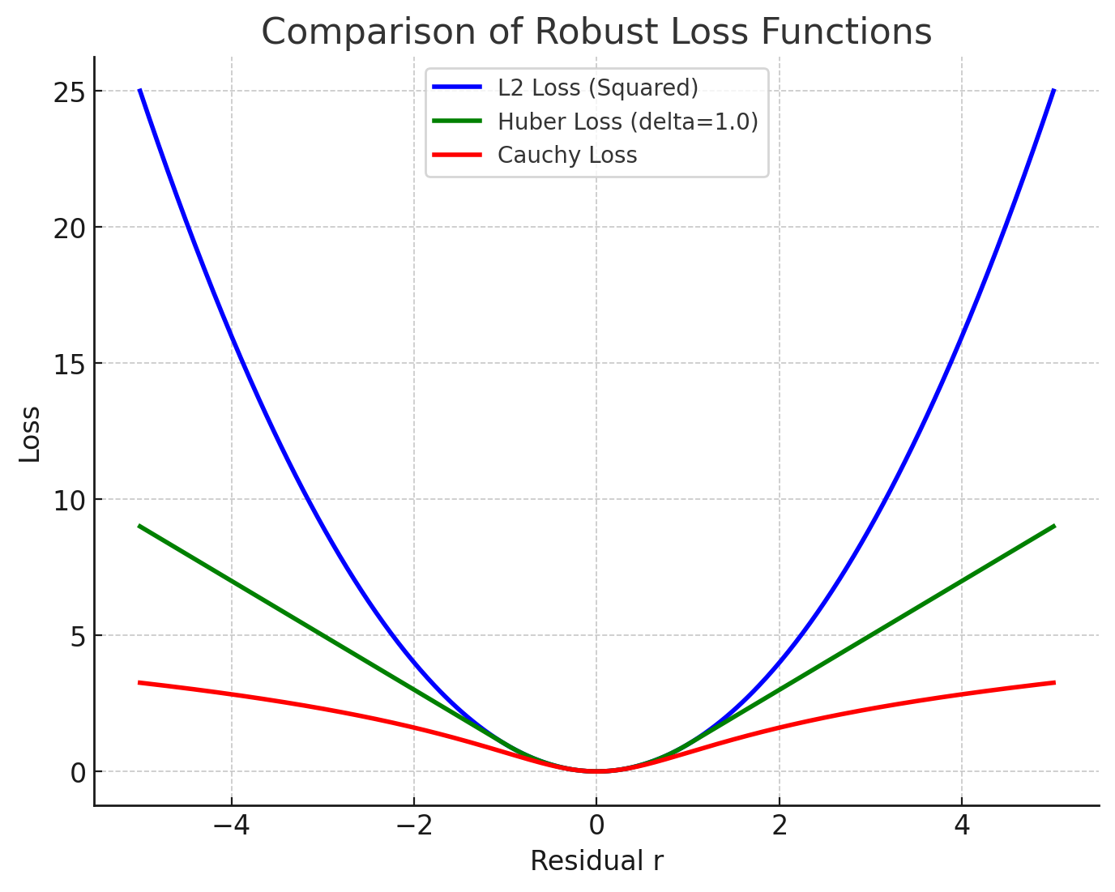
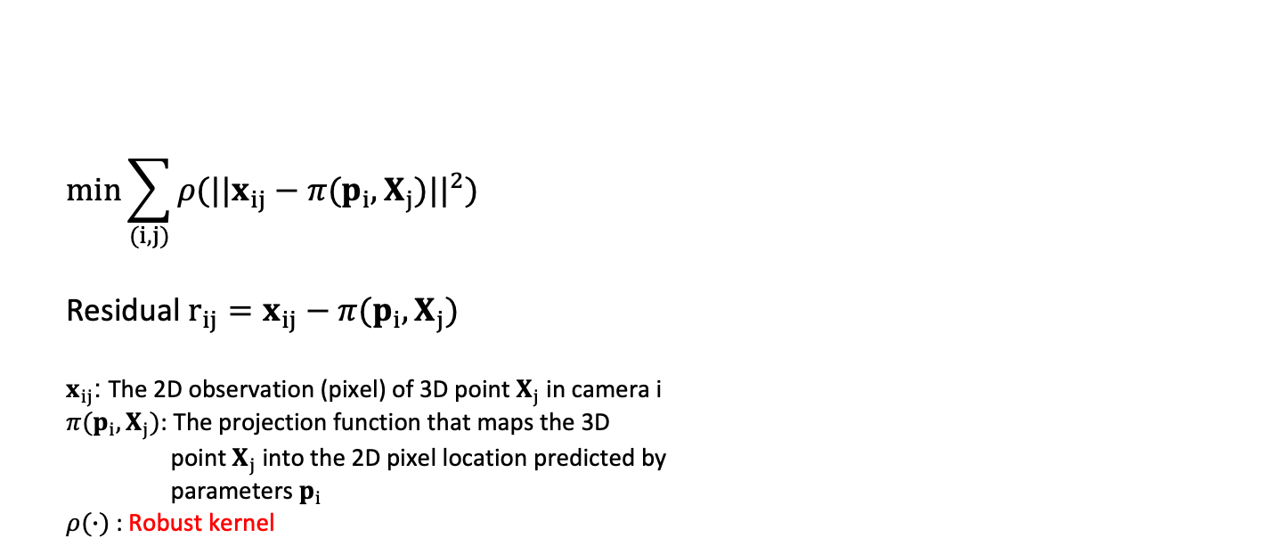
COLMAP: Bundle Adjustment
Least squares approach to jointly estimate camera poses and 3D points
Minimize “reprojection error”
$$\min_{ }{\sum_{(i,j)}{ρ({||x_{ij}−π(p_{i},X_{j})||}^{2})}}$$
Residual $r_{ij}=x_{ij}−π(p_{i},X_{j})$
$x_{ij}$: The 2D observation (pixel) of 3D point $X_{j}$ in camera i
$π(p_{i},X_{j})$: The projection function that maps the 3D
point $X_{j}$ into the 2D pixel location predicted by
parameters $p_{i}$
$ρ(∙)$ : Robust kernel
Notes:
Rotation invariant, translation invariant

Slide 13
3D Reconstruction Methods
Deep Learning
Optimization-based
Optimization-based
Feed-forward
With Global Alignment:
DUSt3R, MASt3R
Scene Coordinate Reconstruction:
ACE0
Others:
FlowMap, VGGSfM
VGGT-based:
SAIL-Recon
DUSt3R-based:
Cut3R, Fast3R
Incremental:
COLMAP
Global:
GLOMAP

Slide 14
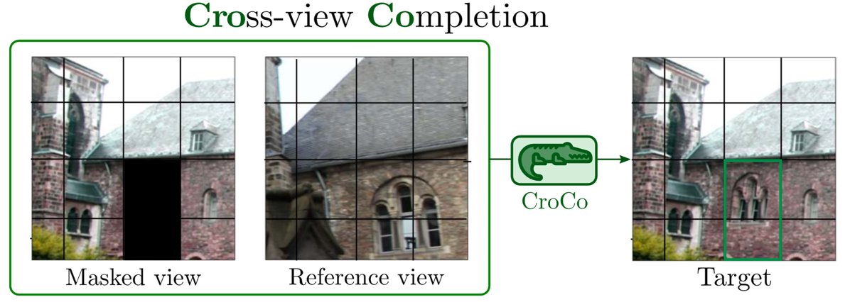
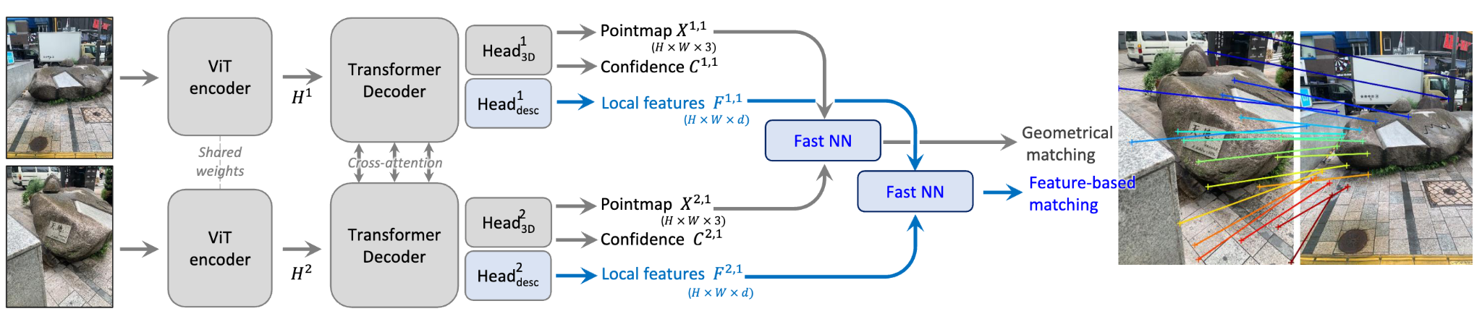
DUSt3R (MASt3R)
CroCo pre-trained encoder
Input: “Two” images
Output: Pointmap, Confidence, Local features
Image Matching in 3D
https://arxiv.org/pdf/2210.10716
https://arxiv.org/pdf/2406.09756
Notes:
Rigid Transformation, scaling

Slide 15
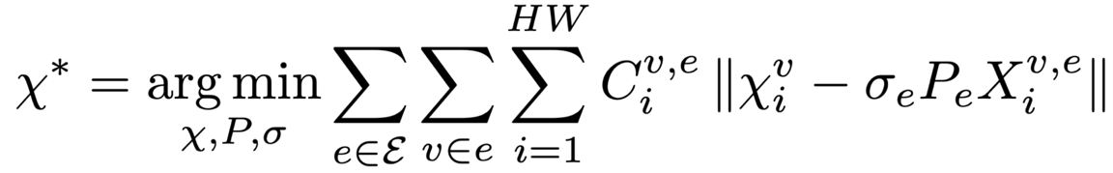

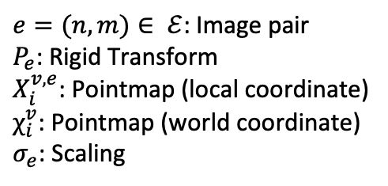
DUSt3R (MASt3R)
$e=(n,m)∈ ℰ$: Image pair
$P_{e}$: Rigid Transform
$Χ_{i}^{v,e}$: Pointmap (local coordinate)
$χ_{i}^{v}$: Pointmap (world coordinate)
$σ_{e}$: Scaling
Given a set of images $\{I^{1},I^{2}, …,I^{N}\}$,
=> Construct a connectivity graph $𝒢(𝒱,ℰ)$
https://arxiv.org/pdf/2406.09756
Notes:
Rigid Transformation, scaling

Slide 16
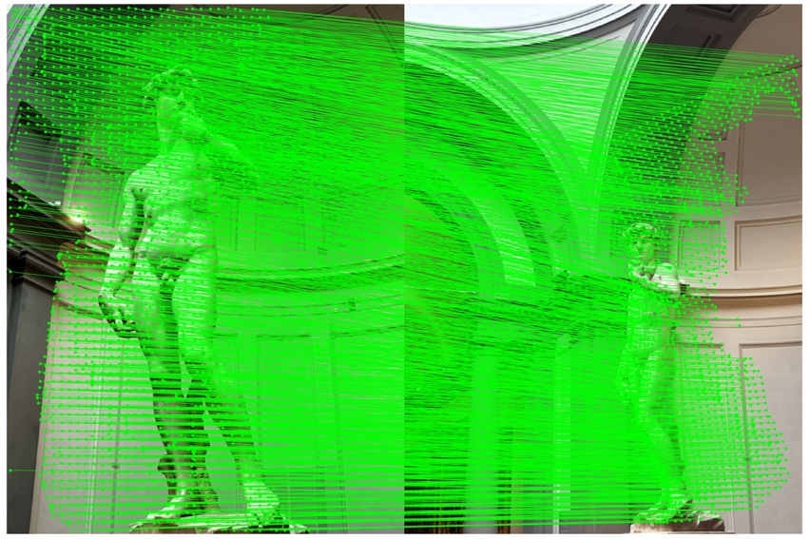
DUSt3R (MASt3R)
$e=(n,m)∈ ℰ$: Image pair
$P_{e}$: Rigid Transform
$Χ_{i}^{v,e}$: Pointmap (local coordinate)
$χ_{i}^{v}$: Pointmap (world coordinate)
$σ_{e}$: Scaling
Given a set of images $\{I^{1},I^{2}, …,I^{N}\}$,
=> Construct a connectivity graph $𝒢(𝒱,ℰ)$
https://arxiv.org/pdf/2406.09756
Notes:
Rigid Transformation, scaling

Slide 17
3D Reconstruction Methods
Deep Learning
Optimization-based
Optimization-based
Feed-forward
With Global Alignment:
DUSt3R, MASt3R
Scene Coordinate Reconstruction:
ACE0
Others:
FlowMap, VGGSfM
VGGT-based:
SAIL-Recon
DUSt3R-based:
Cut3R, Fast3R
Incremental:
COLMAP
Global:
GLOMAP

Slide 18
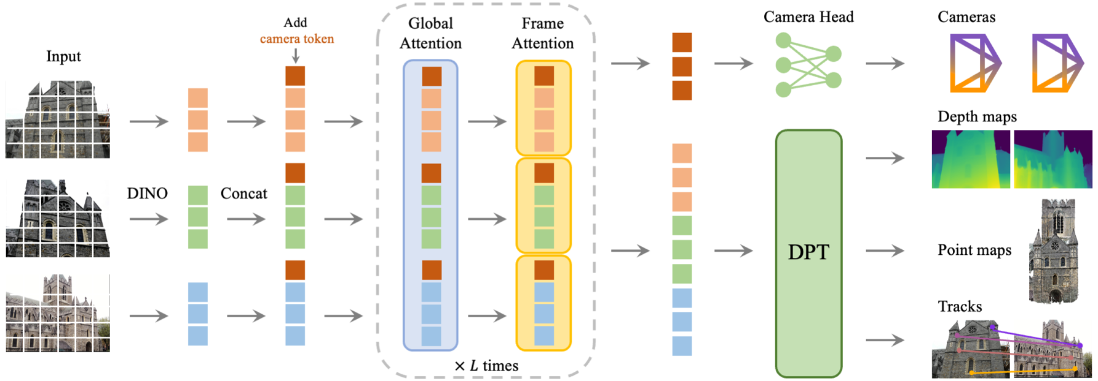
VGGT
Feed-forward method
Input: (Un)ordered Images
Output: Camera parameters, point maps, depth maps, and 3D point tracks
https://arxiv.org/pdf/2503.11651

Slide 19
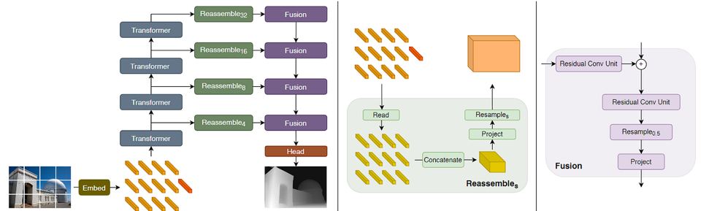
VGGT
Dense prediction transformer (DPT)
Embed: Flattening non-overlapping patches + linear projection (same as ViT)
Different
Transformer
Stages
https://arxiv.org/pdf/2103.13413

Slide 20
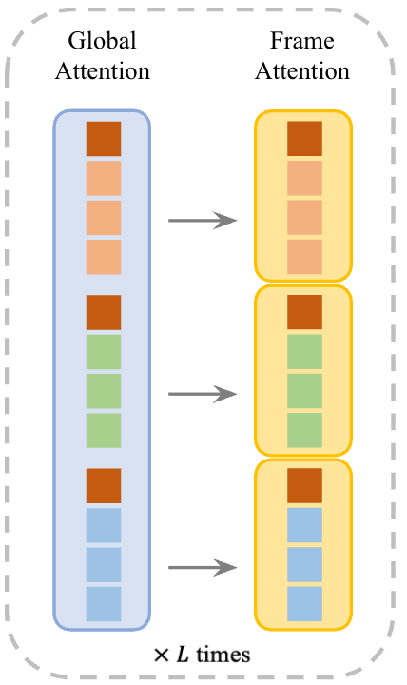
VGGT: Alternating-Attention
Global attention
Ensures scene-level coherence
Frame-wise attention
Eliminates frame index embedding
For permutation equivariance (input -> output)
For flexible input length
https://docs.google.com/presentation/d/1JVuPnuZx6RgAy-U5Ezobg73XpBi7FrOh/edit?slide=id.p9#slide=id.p9

Slide 21
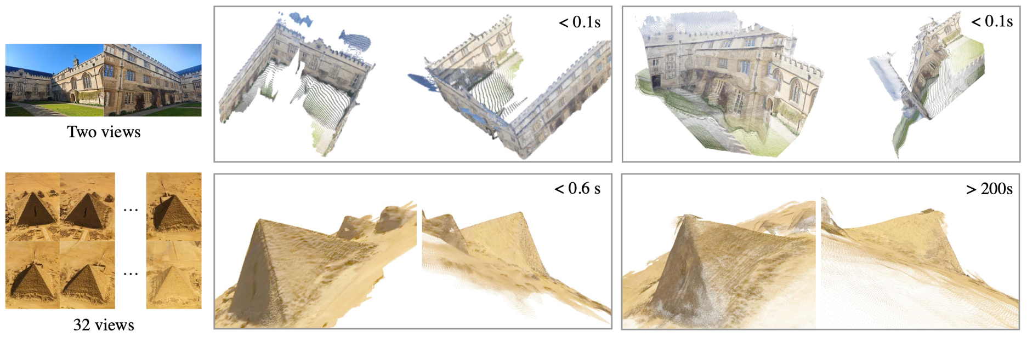
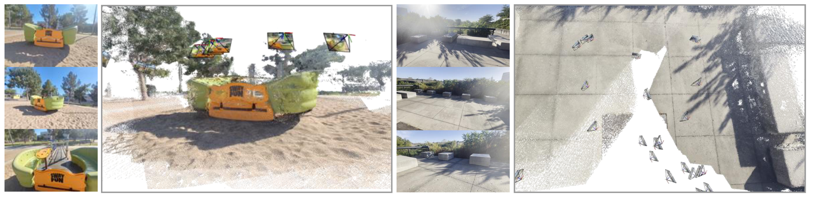
VGGT
https://arxiv.org/pdf/2503.11651

Slide 22
3D Reconstruction Methods
Deep Learning
Optimization-based
Optimization-based
Feed-forward
With Global Alignment:
DUSt3R, MASt3R
Scene Coordinate Reconstruction:
ACE0
Others:
FlowMap, VGGSfM
VGGT-based:
SAIL-Recon
DUSt3R-based:
Cut3R, Fast3R
Incremental:
COLMAP
Global:
GLOMAP

Slide 23
Feed-forward 3D Reconstruction
Strengths
Weaknesses
Speed (cf. Bundle Adjustment, Global Alignment)
Learned priors from data
Reduced error accumulation
Generalization
Accuracy

Slide 24
Current Problems & Perspectives
Scalability (OOM) - Fast3R
Large-scale 3D Reconstruction - SAIL-Recon
Online 3D Reconstruction - Cut3R

Slide 25
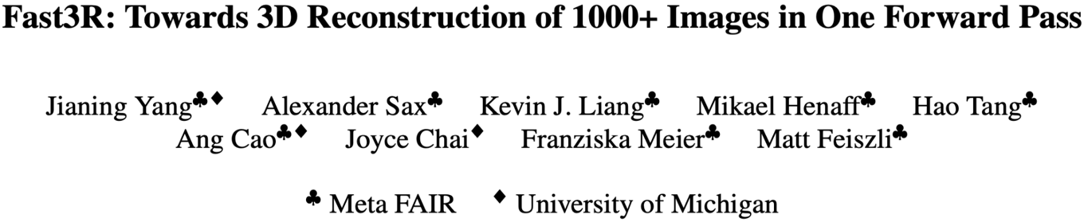
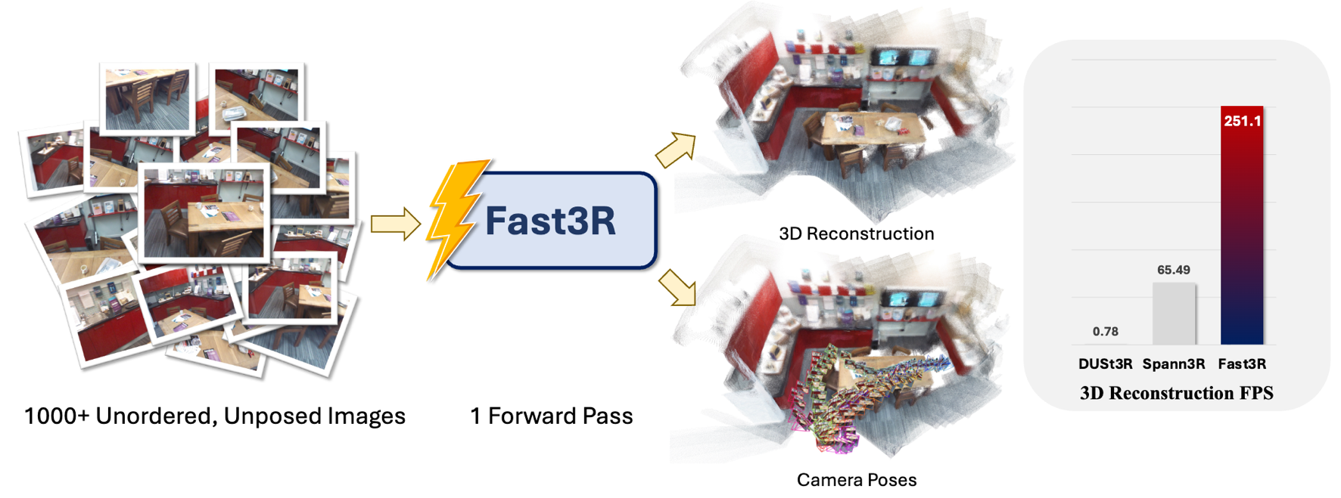
Fast3R
Scalability (OOM) - Fast3R
https://arxiv.org/pdf/2501.13928

Slide 26
Fast3R
Observation 1. DUSt3R leads to OOM with only 48 views on an A100 GPU 2. DUSt3R computes O(N²) pairs of pointmaps and performs a global alignment optimization procedure 3. DUSt3R suffers from the same pair-wise bottleneck as traditional SfM

Slide 27
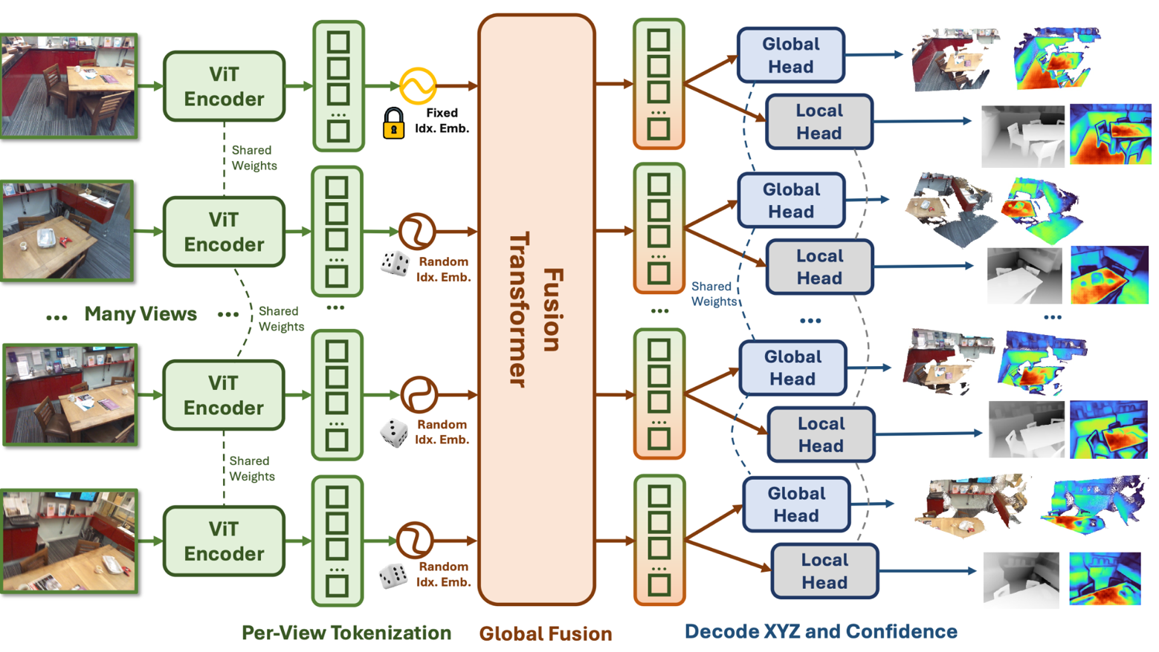
Fast3R
Inputs: Unordered, unposed, RGB images
I → (X_{L}, Σ_{L}, X_{G}, Σ_{G})
Global Pointmap X_{G}: In the coordinate frame of the 1st
camera
Local Pointmap X_{L}: In the coordinate frame of the viewing
camera
Feature Patches
Align X_{L} to X_{G} using ICP => Aligned local pointmaps => 3D reconstruction
all-to-all self-attention
(DPT)
https://arxiv.org/pdf/2501.13928
Notes:
local pointmap head learns more accurate pointmaps than the global pointmap head
Independently align each image’s local pointmap to the global pointmap using ICP and use aligned local pointmaps for evaluation.

Slide 28

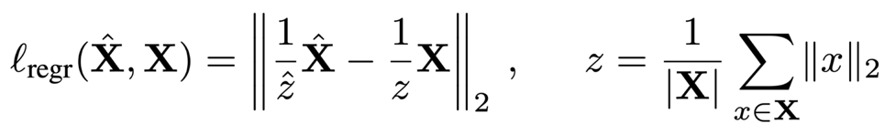
Fast3R: Technical Highlights
Training Objective: ℒ_{total} = ℒ_{XG} + ℒ_{XL} ; Confidence-weighted versions of the normalized 3D pointwise regression loss
Fast3R can handle more views at inference than were used to train a model
Dataset: CO3D, ScanNet++, ARKitScenes, Habitat, BlendedMVS, MegaDepth (less than DUSt3R)
Naive way: Spherical Harmonic
- Trainging: SH({1, 2, …, N}) - Testing: SH({1, 2, …, N_{test}})
Adoption: Position Interpolation
- Draw N ⊂ {1, 2, …, N’} indexes uniformly at random (N’ ≫ N)
Masking!
Notes:
e.g. N = 20, N’ = 1000

Slide 29
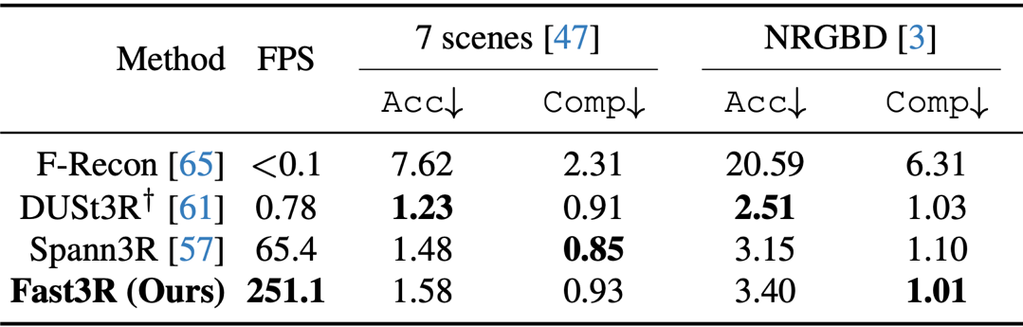
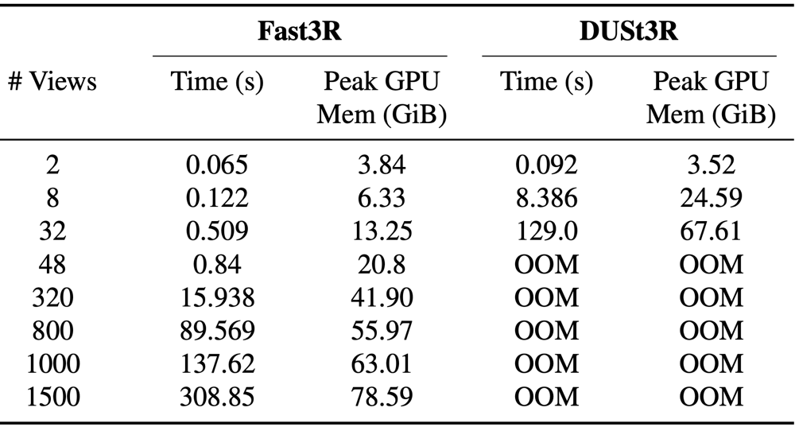
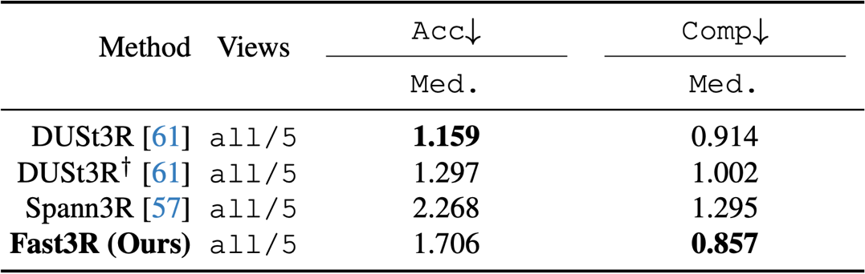
Fast3R: Experiments
3D Reconstruction
Inference Efficiency
Skip = 20
Skip = 40
DTU
https://arxiv.org/pdf/2501.13928

Slide 30
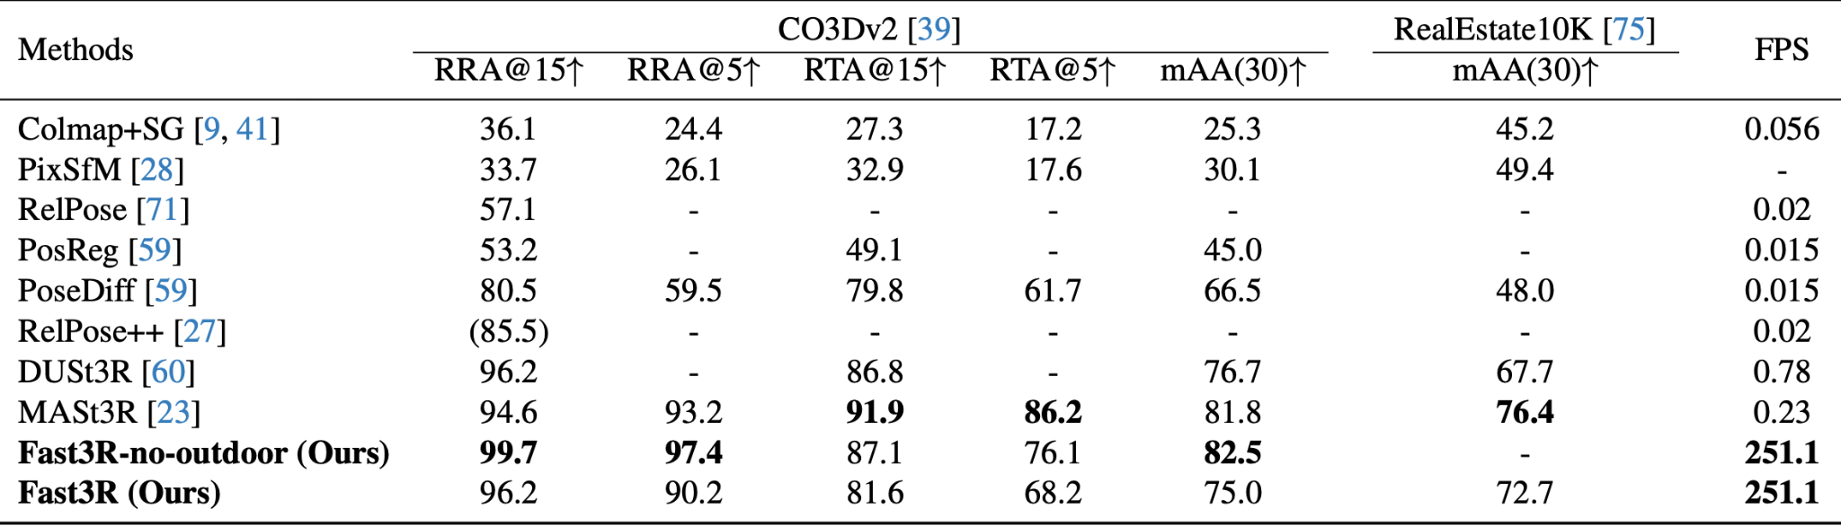
Fast3R: Experiments
Pose Estimation
https://arxiv.org/pdf/2501.13928

Slide 31
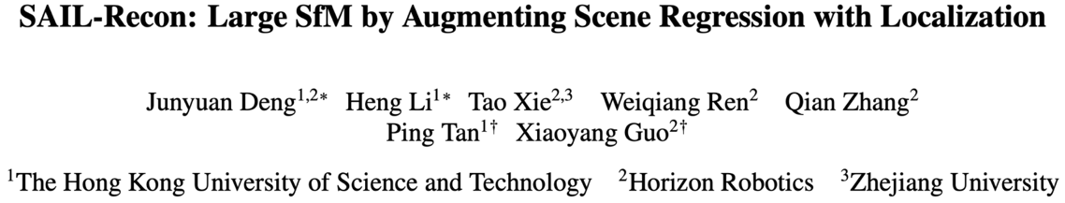
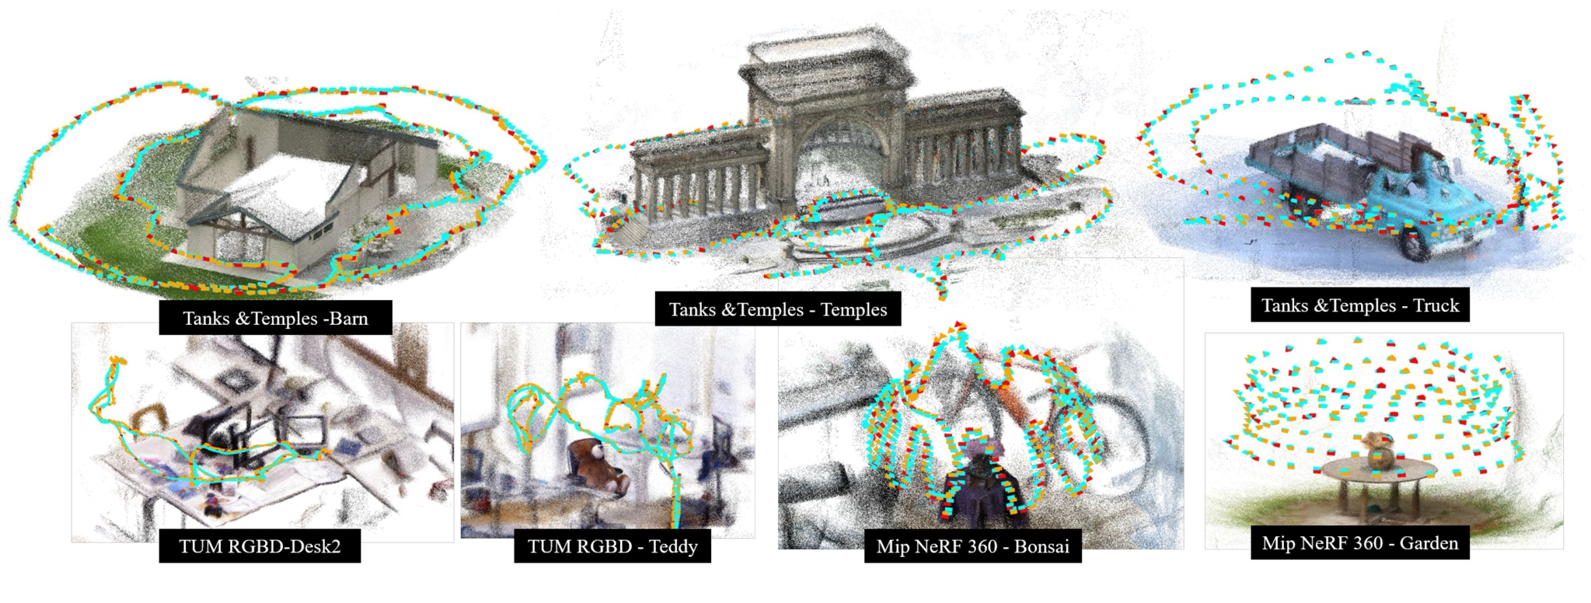
SAIL-Recon
Based on VGGT
Large-scale 3D Reconstruction - SAIL-Recon
https://arxiv.org/pdf/2508.17972
Notes:
COLMAP or ground-truth camera poses are shown as blue frustums, while regressed camera poses are shown in
yellow, with red indicating anchor images.

Slide 32
SAIL-Recon
Observation 1. VGGT struggle to handle a large number of input images 2. Current large-scale, incremental reconstruction methods suffer from pose drift and are highly dependent on subsequent global alignment (e.g. online, divide and conquer methods) 3. Existing SCR methods ignore visual localization, a common approach to scale up an SLAM system

Slide 33




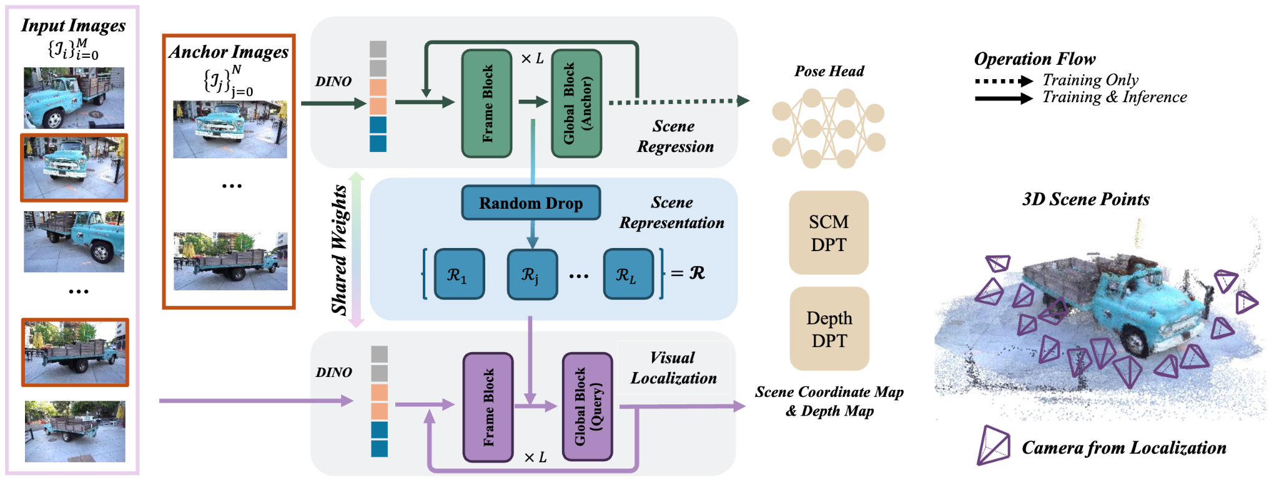
SAIL-Recon
: Transformer-based
network
: Extrinsic matrices
: Intrinsic matrices : Query image
Inputs: Unordered, unposed, RGB images
L = 24 layers of frame-wise and global self-attention
S_{i}
D_{i}
Notes:
Attention mask is applied during inference. Specifically, tokens from query frames cannot attend to tokens from other query frames; they can only attend to tokens within the same frame and to the scene representation

Slide 34


SAIL-Recon: Technical Highlights
Neural scene representation serves as an implicit neural map of the scene, without relying on explicit 3D points or meshes
Most localization methods require per-scene training of the network => SAIL-Recon circumvents this by deriving a latent scene representation through scene regression
Uniformly sample N ∈ [50, 100] anchor frames f from the full set

Slide 35
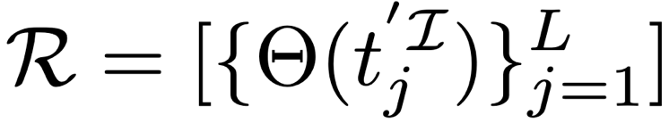


SAIL-Recon: Technical Highlights
The network takes a set of 2D images as input and progressively enhances them to compute 3D structures
=> Extract intermediate feature tokens from each attention layer of to form the scene representation R (Captures the gradual evolution from 2D appearance features to 3D coordinate descriptors)
𝚯 : Downsampling operation : Intermidate feature tokens
Randomly select a ratio r ∈ [0.2, 1.0] => Sample a subset of tokens in each anchor frame to control the total size of

Slide 36
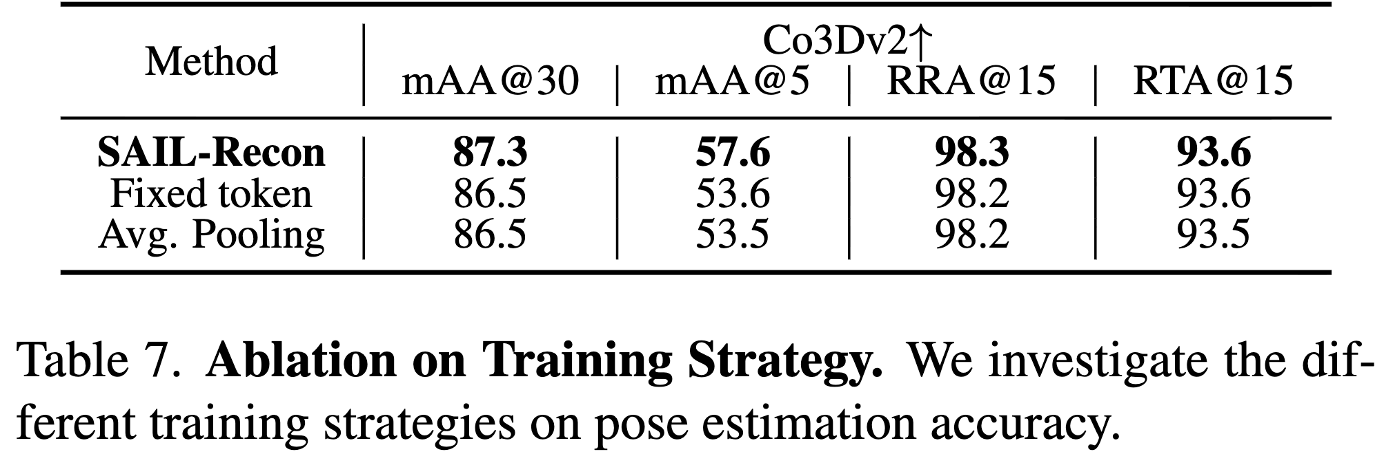
SAIL-Recon: Technical Highlights
300 per image
𝚯 : Downsampling operation : Intermidate feature tokens
Randomly select a ratio r ∈ [0.2, 1.0] => Sample a subset of tokens in each anchor frame to control the total size of

Slide 37



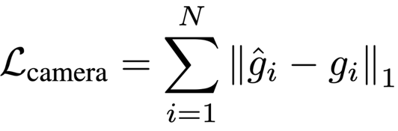
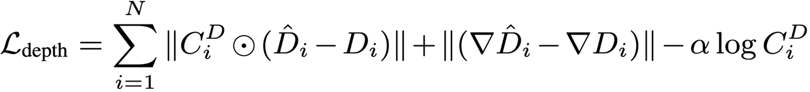
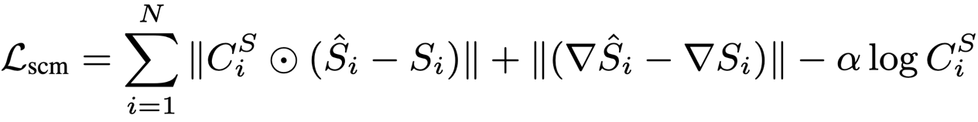
SAIL-Recon: Technical Highlights
: Uncertainty Map
:
Camera Parameters q: Camera orientation
t: Translation vector
f: Field of View
Training Objective: (Fine-tuning VGGT checkpoints)
Gradient-based smooth
With normalization w.r.t. a randomly selected image in anchor frames
Notes:
⊙: element-wise product compute the average Euclidean distance from the camera center of Ir to the 3D points of all anchor frames.

Slide 38
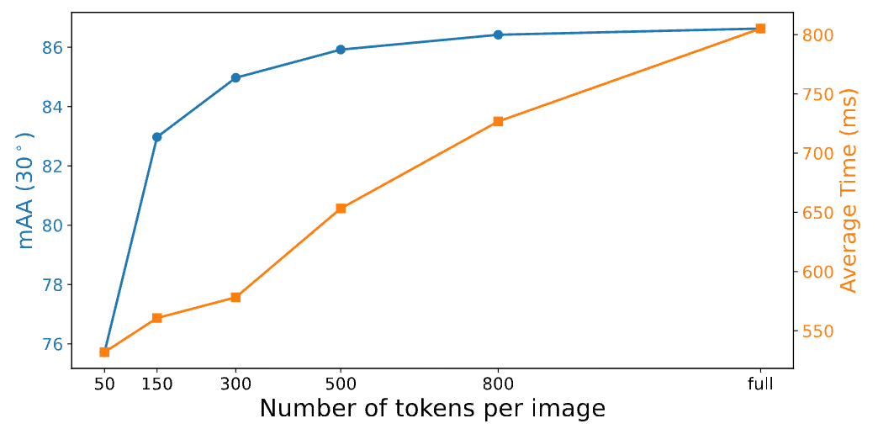
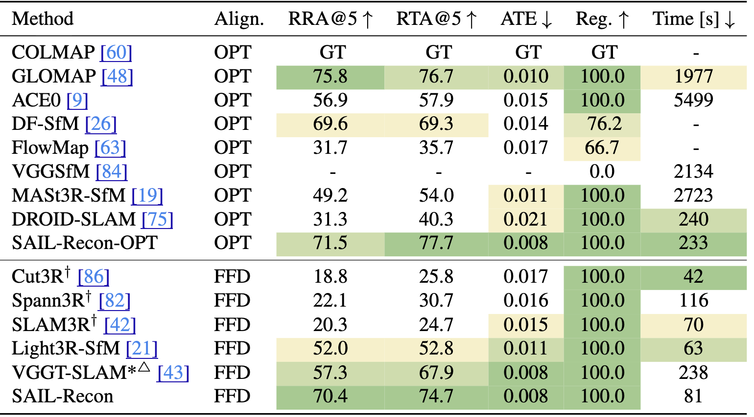
SAIL-Recon: Experiments
Pose Accuracy - Tanks & Temples.
Notes:
⊙: element-wise product compute the average Euclidean distance from the camera center of Ir to the 3D points of all anchor frames.

Slide 39
SAIL-Recon: Experiments
Pose Accuracy - Tanks & Temples.
The evaluation of camera poses is sometimes unreliable, as the pseudo ground-truth from
COLMAP is only an estimation!
Notes:
⊙: element-wise product compute the average Euclidean distance from the camera center of Ir to the 3D points of all anchor frames.

Slide 40
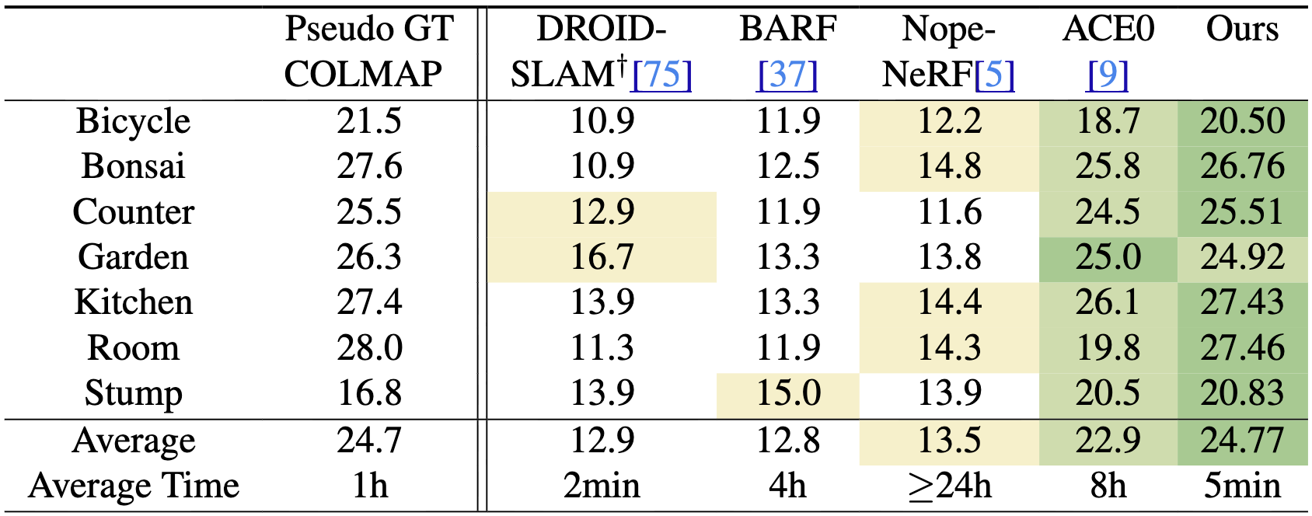
SAIL-Recon: Experiments
Pose accuracy via view synthesis on Mip-NeRF 360 PSNR
Notes:
We first estimate camera poses for all images of a scene. We then split these images into training and testing sets, and train a Nerfacto model on the training set and render images in the testing view.

Slide 41
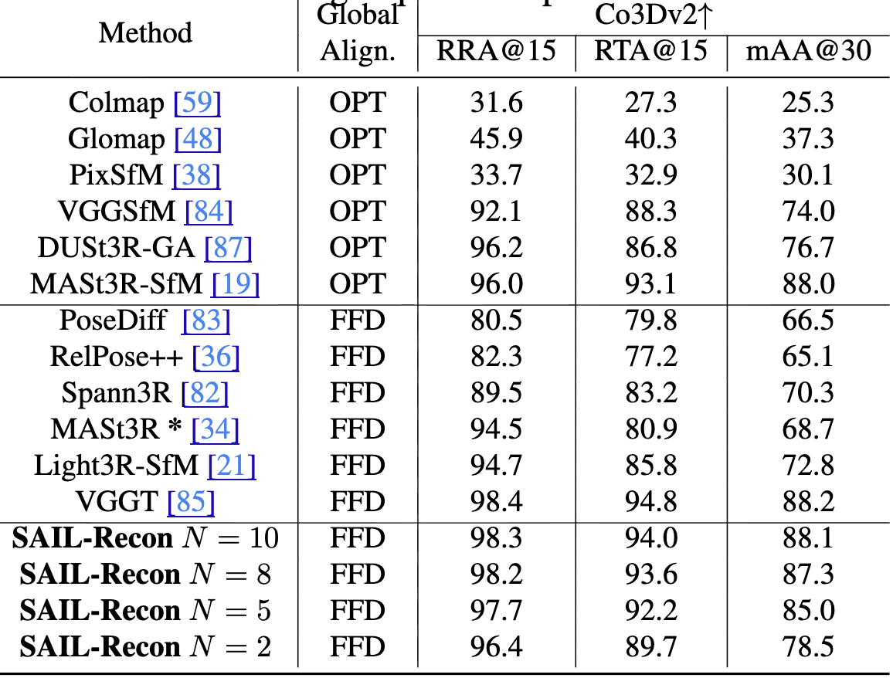
SAIL-Recon: Ablation
Ablation on the number of anchor views for pose estimation performance on Co3Dv2 # of input images: 10
Notes:
⊙: element-wise product compute the average Euclidean distance from the camera center of Ir to the 3D points of all anchor frames.

Slide 42
Demo
Notes:
⊙: element-wise product compute the average Euclidean distance from the camera center of Ir to the 3D points of all anchor frames.

Slide 43
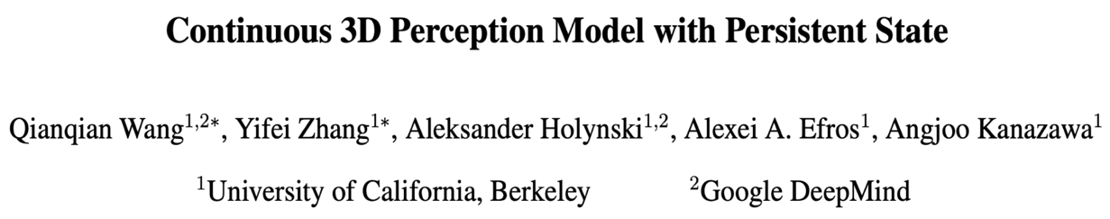
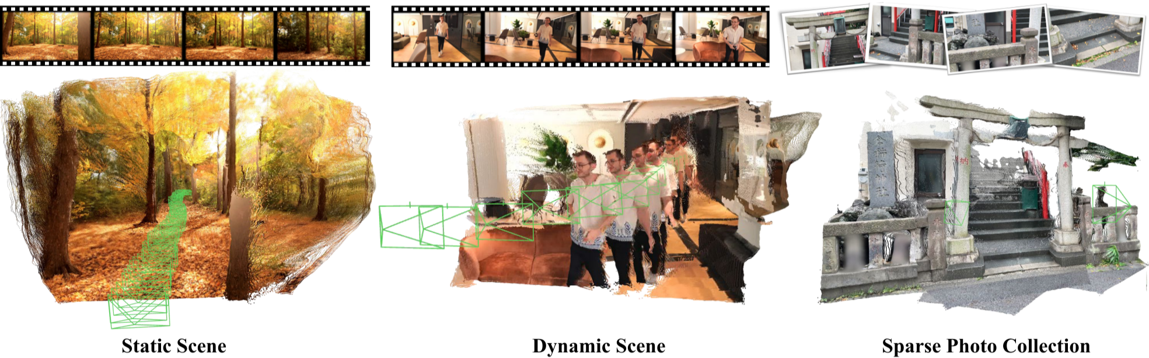
Cut3R
Online 3D Reconstruction - Cut3R
https://arxiv.org/pdf/2501.12387

Slide 44
Cut3R
Observation 1. Many 3D reconstruction pipelines operate as tabula rasa, starting from scratch for each new scene (e.g. SfM, SLAM, …) => Poses challenges in handling scenarios with sparse observations 2. Current continuous reconstruction methods have limitation such as being object-centric, or limited to static scenes

Slide 45
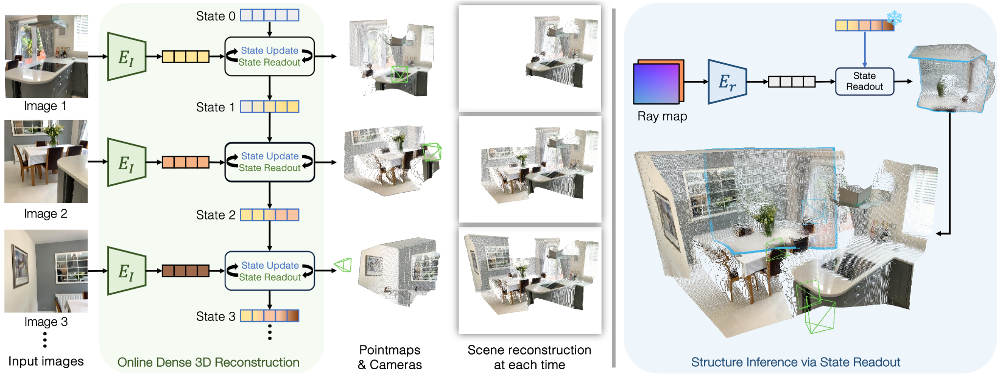
Cut3R
Ray map R:
A 6-channel image encoding the origin and direction of rays at each pixel
Inputs: Stream of images without any camera information
Separate transformer Encoder
Share Weights
Poses
https://arxiv.org/pdf/2501.12387
Notes:
ViT encoder & ViT decoder The state0 tokens are initialized as a set of learnable tokens shared by all scenes
State consists of 768 tokens

Slide 46

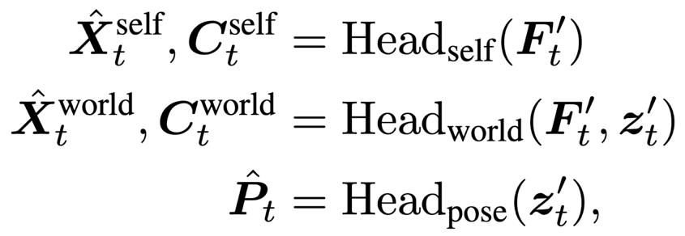

Cut3R: Technical Highlights
The bidirectional interaction (update and readout) is implemented using two interconnected transformer decoders
Redundancy simplifies training (i.e. )
All pointmaps and poses are in metric scale (i.e. meters)
F_{t} : Image tokens
z : Learnable pose token X_{t} : Pointmap
C_{t} : Confidence map
P_{t} : (6-DoF) Relative transformation
DPT
MLP
Notes:
Within the decoders, the outputs from both sides cross-attend to each other at each decoder block to ensure effective information transfer.

Slide 47
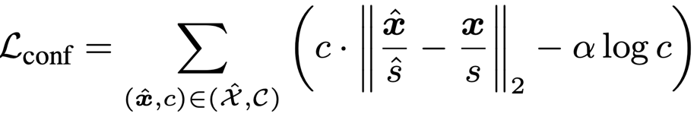

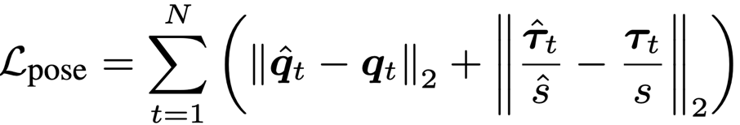
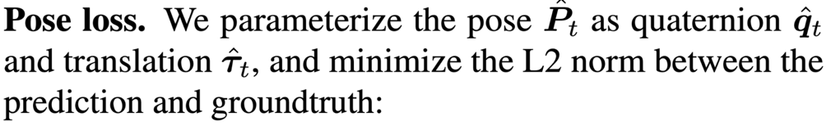


Cut3R: Technical Highlights
Training Objective
Confidence-aware regression loss to the pointmaps. (When GT pointmaps are metric: set )
MSE loss. When the input is raymap, we also apply MSE loss to enforce the predicted pixel colors to match the groundtruth
Notes:
Within the decoders, the outputs from both sides cross-attend to each other at each decoder block to ensure effective information transfer.

Slide 48
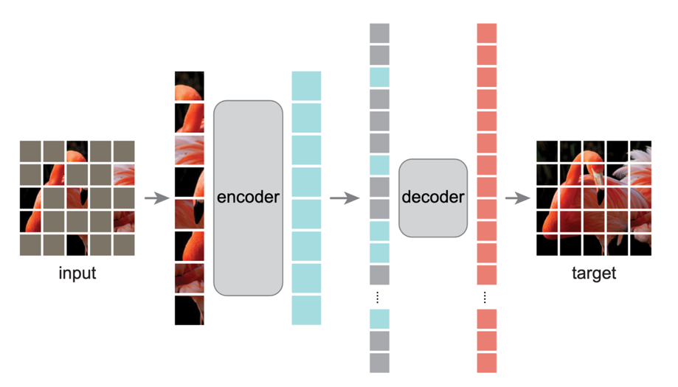
Cut3R: Analogy
Cut3R
Masked Autoencoders
- Completion occurs at the image level
- Using global context of the 3D scene captured in the state.
- Completion occurs at the patch level
- Using global context of the entire image

Slide 49
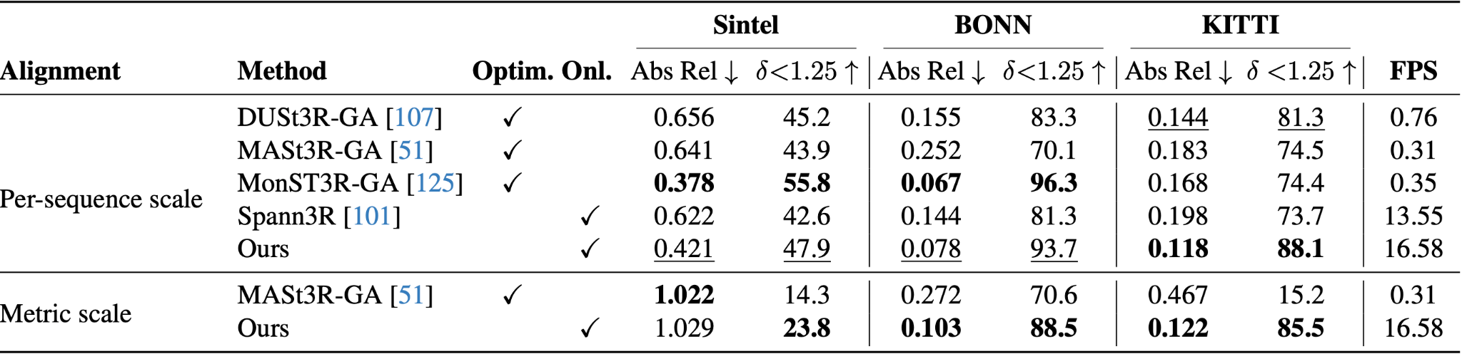

Cut3R: Experiments
Video Depth Estimation
Absolute relative error (Abs Rel)
: Percentage of predicted depths within a 1.25-factor of true depth

Slide 50
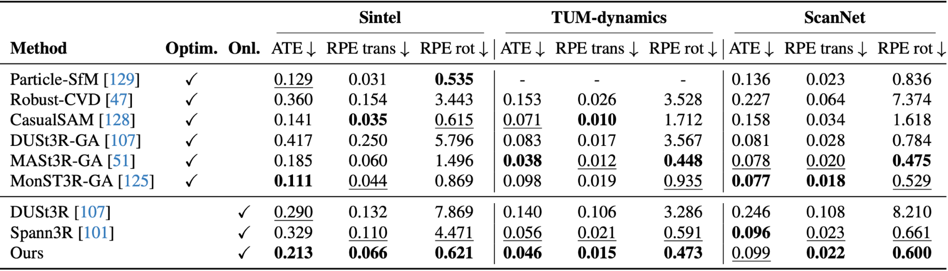
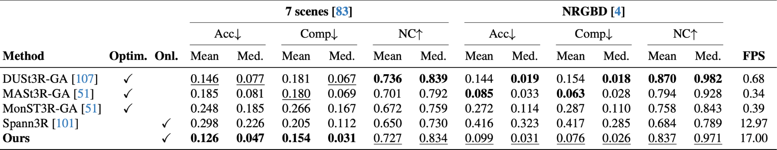
Cut3R: Experiments
Camera Pose Estimation
3D Reconstruction
Notes:
We additionally include DUSt3R where we align all video frames with first frame, without using GA NC: normal consistency (mean of the dot product of the ground truth and predicted normals)

Slide 51
Demo
Dynamic Scene 1
Dynamic Scene 2
Static Scene
Notes:
We additionally include DUSt3R where we align all video frames with first frame, without using GA NC: normal consistency (mean of the dot product of the ground truth and predicted normals)

Slide 52


3D Reconstruction Application: AR/VR
Apple ARKit – RoomPlan
Meta Quest 3 spatial anchoring
https://www.meta.com/zhtw/help/quest/625635239532590/

Slide 53

3D Reconstruction Application: Medical Imaging
Endoscopy surface reconstruction
Endoscopy images from VR simulators: https://arxiv.org/pdf/2008.12949
Surface reconstruction results from MPAC work

Slide 54




3D Reconstruction Application: Robotics
Autonomous Mapping of the Priscilla Catacombs
https://homes.esat.kuleuven.be/~konijn/publications/2017/978-3-319-49607-8_3.pdf

Slide 55

3D Reconstruction Application: Autonomous Driving
SplatAD: Real-Time Lidar and Camera Rendering with 3D Gaussian Splatting for Autonomous Driving (2025 CVPR)
- Rendered images
- Bird’s-eye views of the rendered point cloud
- Point clouds overlaid on images, with points colored based on range and intensity.
https://research.zenseact.com/publications/splatad/

Slide 56
References
[1] Qianqian Wang, Yifei Zhang, Aleksander Holynski, Alexei A. Efros, and Angjoo Kanazawa. Continuous 3d perception model with persistent state. (CVPR 2025 Oral)
[2] Jianing Yang, Alexander Sax, Kevin J. Liang, Mikael Henaff, Hao Tang, Ang Cao, Joyce Chai, Franziska Meier, and Matt Feiszli. Fast3R: Towards 3d reconstruction of 1000+ images in one forward pass. (CVPR 2025)
[3] Junyuan Deng, Heng Li, Tao Xie, Weiqiang Ren, Qian Zhang, Ping Tan, and Xiaoyang Guo. SAIL-Recon: Large SfM by augmenting scene regression with localization. (2025)

